Slide 1

Bank Management System

Slide 2

Business Model
The primary function of banks includes accepting deposits and granting loans. It can help customers deposit funds, use their checking accounts, make loans, and pay their bills.
Bank Management System would be used to store customer information and track day-to-day credit and debit transactions
It can store data, manage data, and provide facilities tools to search for specific records of customers, banks, and employees in a given set of data.

Slide 3
Assumptions
Each Customer can have at least one account, each Account belongs to one customer.
1
Each branch can have many employees, an employee belongs to only one branch.
2
Each Customer can borrow multiple loans. One loan can be borrowed by one customer.
3
Each branch can have many customers, one customer belongs to one branch.
4
Each loan can have many payments. One payment only belongs to one loan.
5

Slide 4
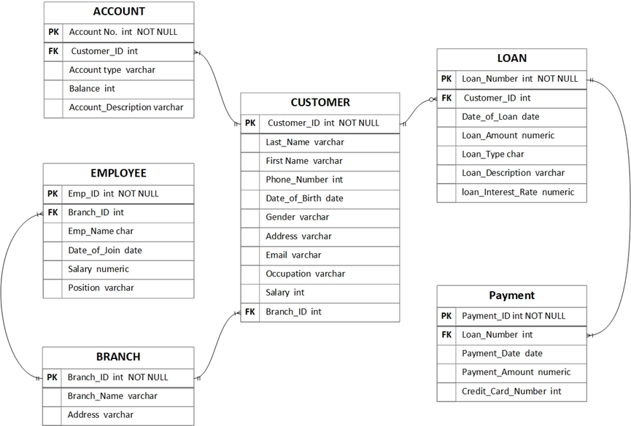
ER Diagram

Slide 5
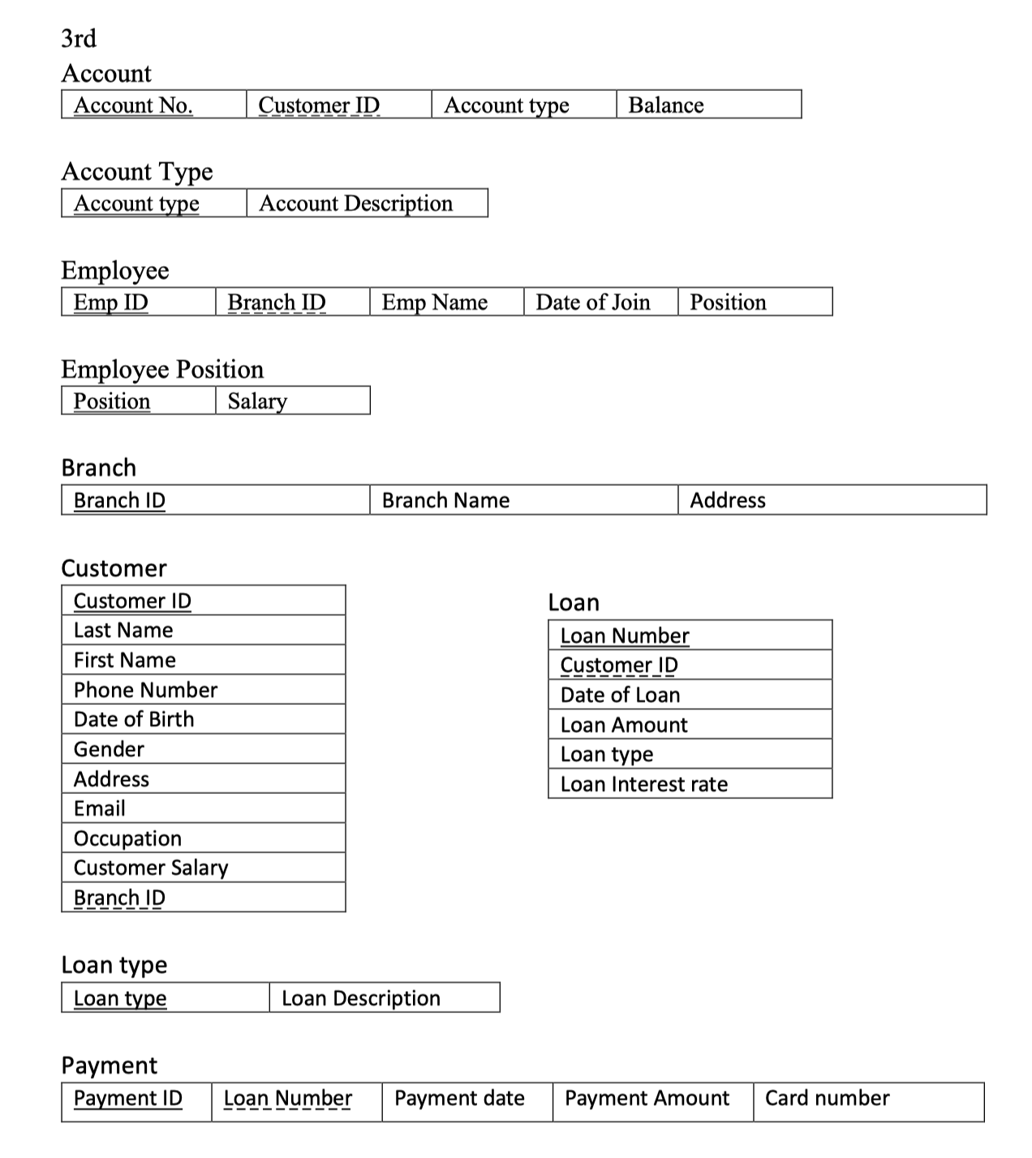
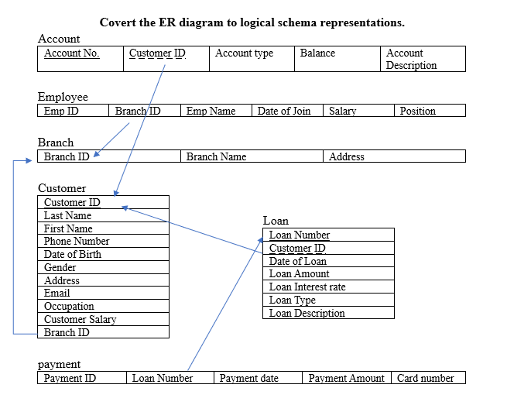
Normalized Logical Schema
This schema isn’t a 3NF, because there are many
transitive dependencies.

Slide 6
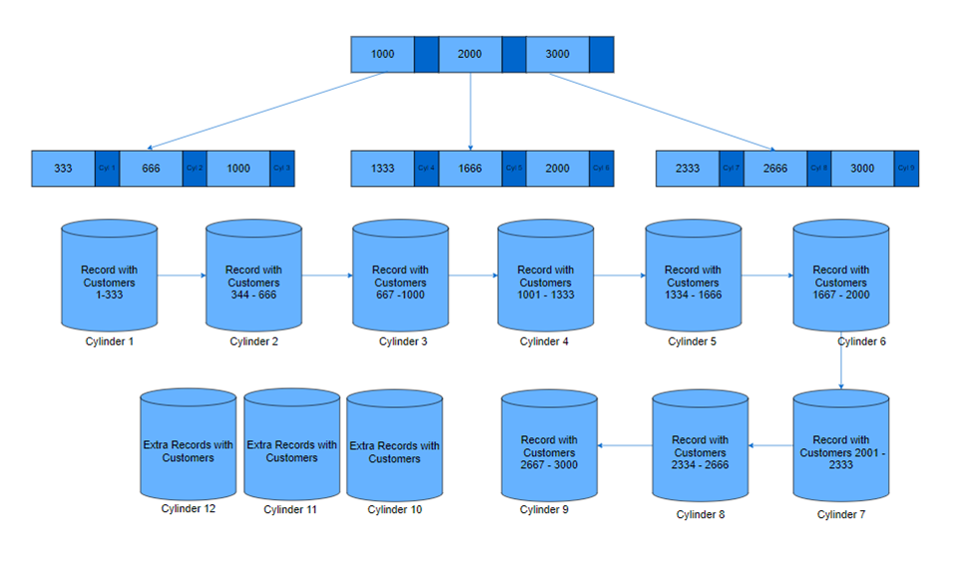
Physical Storage: Customer Table

Slide 7
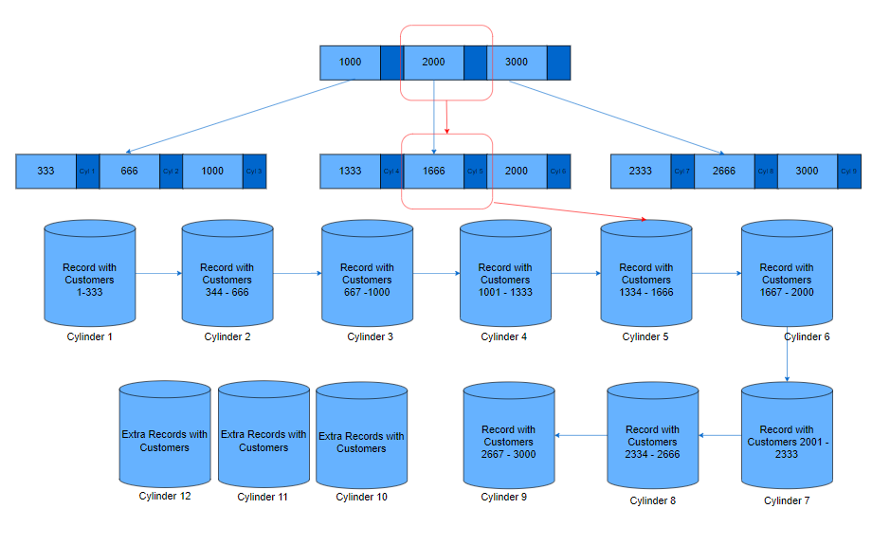
Physical Storage: Customer Table --Search 1365 in the B+ Tree

Slide 8
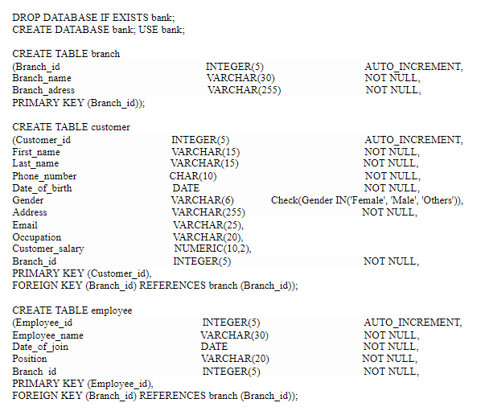
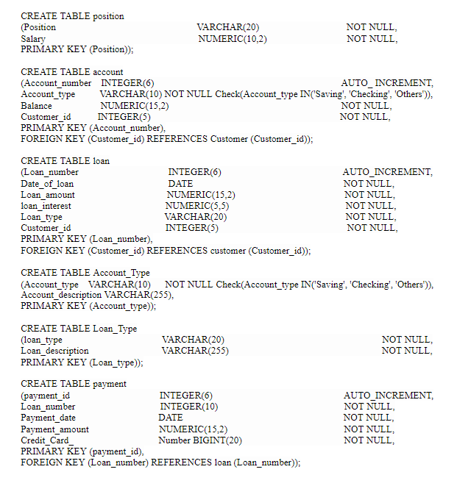
Building a Bank: Database Creation

Slide 9
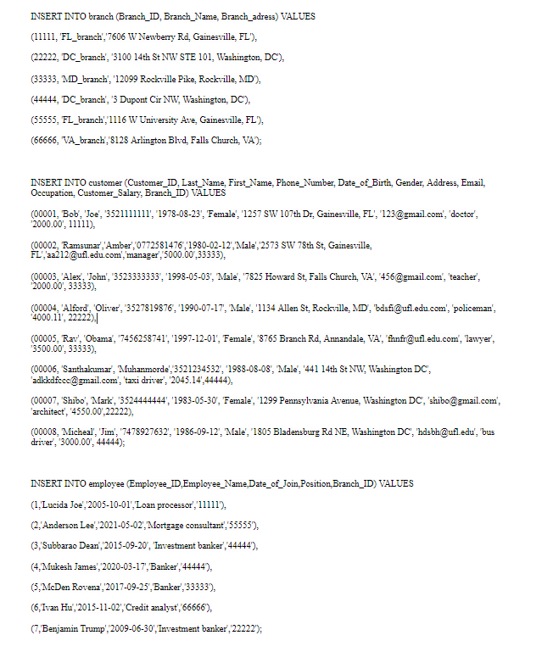
Database Insertion: Employee & Customers

Slide 10
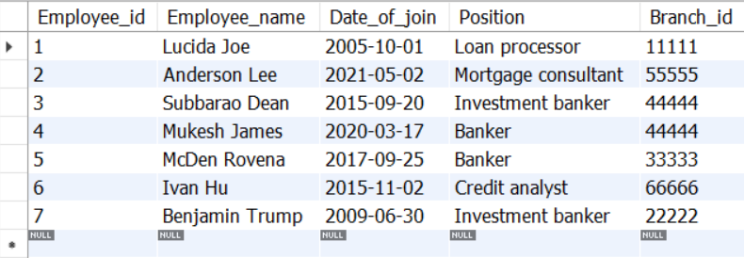
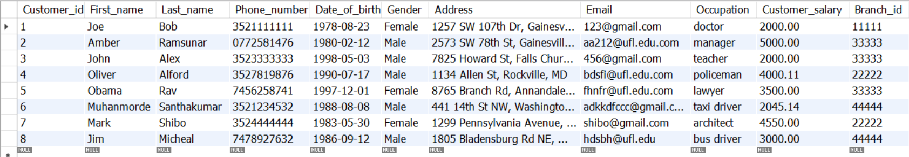
Database Insertion: Employee & Customers

Slide 11
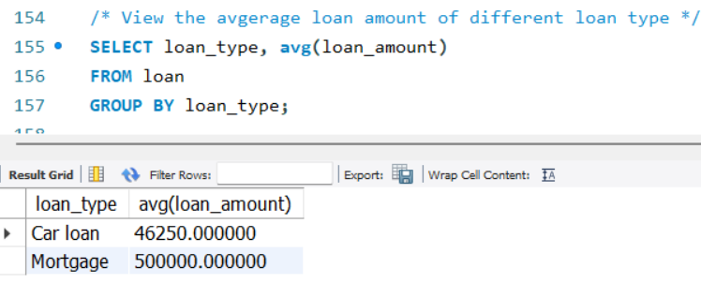
Database Queries: Average Amount Loan Type

Slide 12
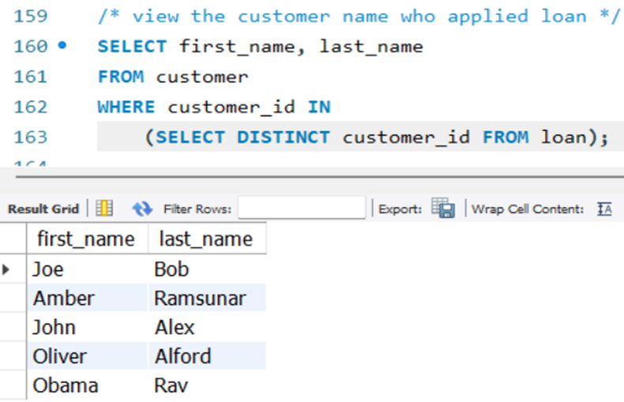
Database Queries :View the Customer who applied loan

Slide 13
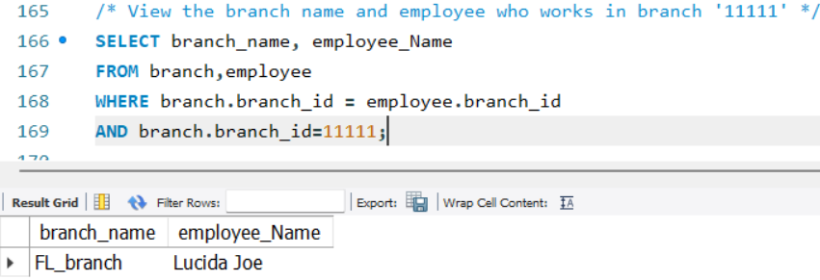
View the branches & Employee In Branch “11111”: Database Queries

Slide 14
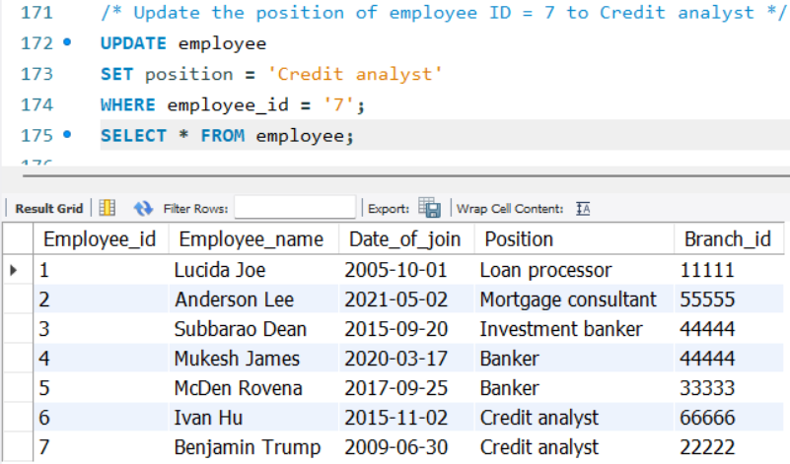
Database Queries :Update Employee Information

Slide 15
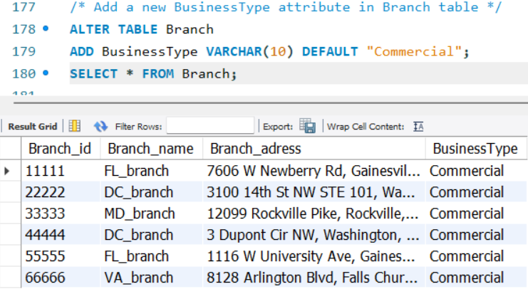
Database Queries : Add Attribute in Branch Table

Slide 16
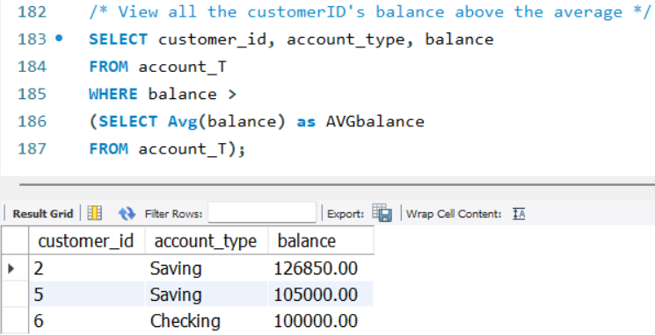
Database Queries : View Balance above Average

